Slide 1
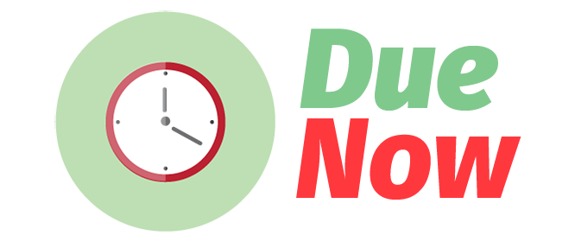
DEVELOPED BY ICEPs
Ian De La Cruz, Chiara Señires, Elysia Villadarez, Pearl Santos

Slide 2
What is Due Now?
Due Now helps you manage your time wisely by giving you suggestions on which task to finish first.

Slide 3
Features
1. Set priority and difficulty.
- You can just define your tasks and specify each one's level of difficulty and set whether the priority is low, medium, or high.
- The app will then categorize your tasks for you, providing suggestions on which task to do first, among other things.
- Avoid the hassle of having to constantly schedule your tasks in a certain period of time.
- The app do the categorizing and scheduling for you.

Slide 4
Features
2. Get notified of deadlines.
- Get desktop notifications whenever deadlines are near, or when there are unfinished tasks that are due soon.
3. Know when to start your tasks
- Be able to plan out your strategy in conquering that giant pile of work by knowing the most efficient time to start your tasks.

Slide 5
Features
4. Get to know your work ethics
- Know the approximate time it takes for you to finish a certain type of task through your recent records of duration in finishing the same kind of tasks stored in the app. Of course, you may also opt to define the duration yourself.

Slide 6
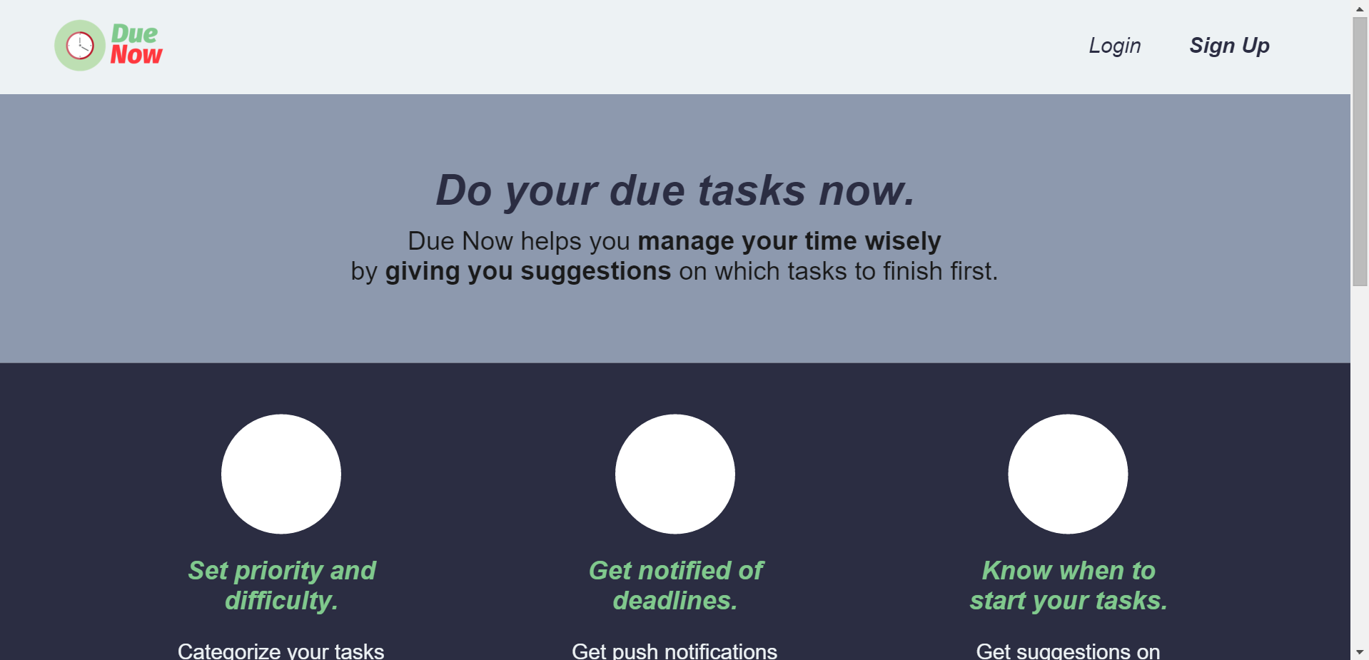
Home Screen

Slide 7
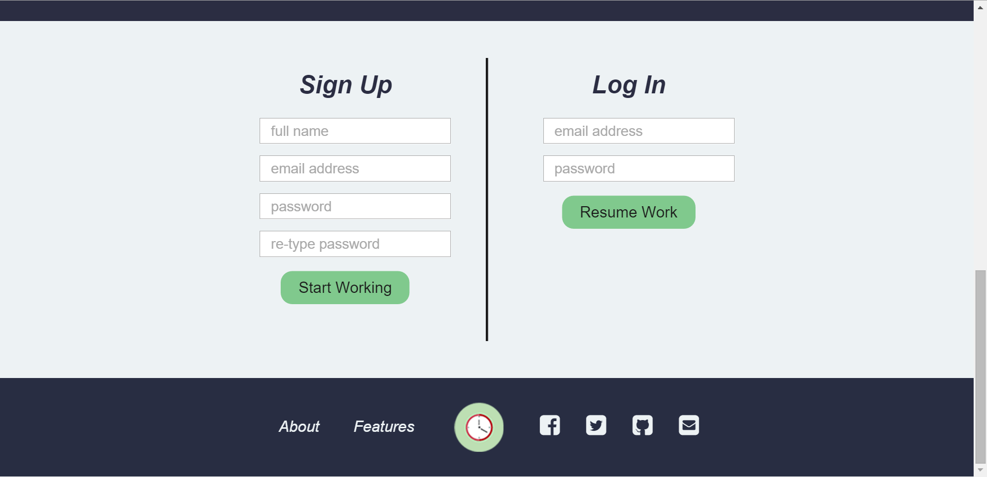
Login

Slide 8
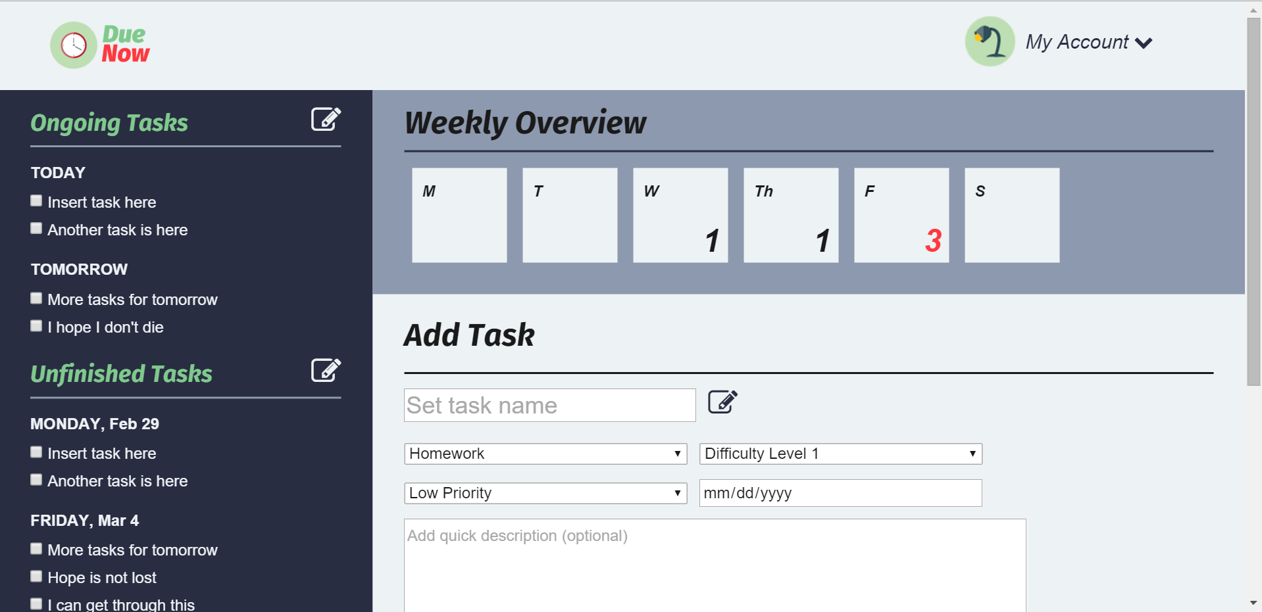
Scheduling Tasks

Slide 9
What makes Due Now different from other scheduling applications?

Slide 10
Questions?

Slide 11
Thank you!

